Slide 1
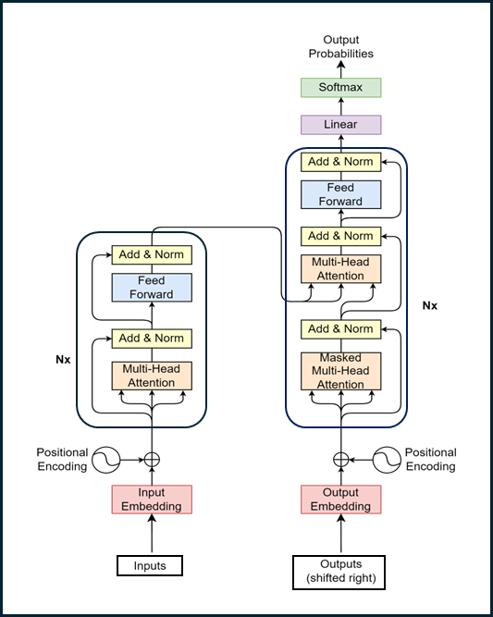
Part 2 – Introduction to Transformer
Quang Duong

Slide 2
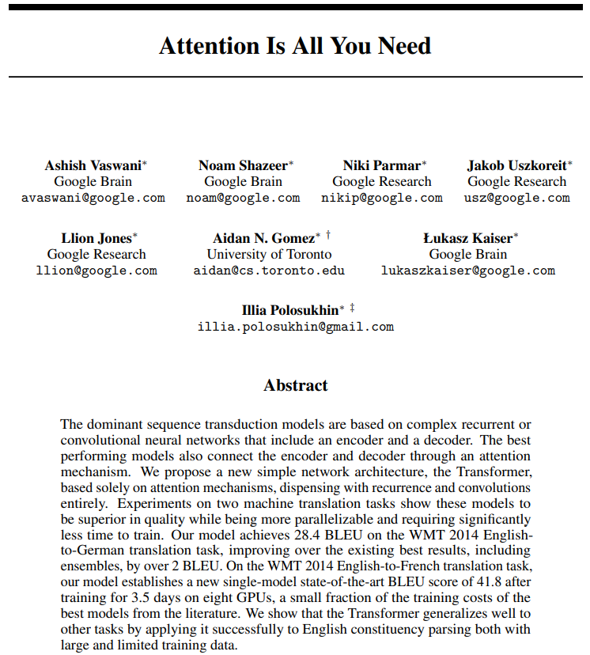
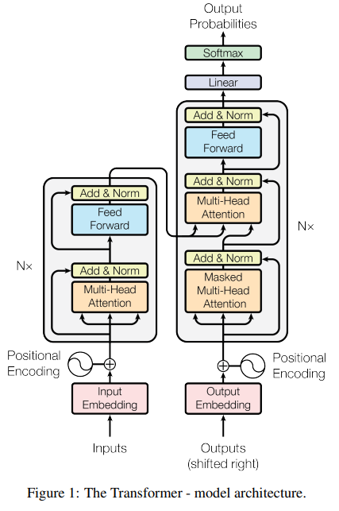
Transformer
Attention Is All You Need, A. Vaswani et al, 2017, https://arxiv.org/abs/1706.03762

Slide 3
What we will learn
Natural Language Processing (NLP) before and after Transformer's arrival
Mastering Transformer's block-by-block
Transformer's training process
Transformer's inference process

Slide 4
NLP Before & After Transformer's arrival

Slide 5
NLP Before Transformer's Arrival in 2017
Recurrent Neural Networks (RNNs)
Long Short-Term Memory (LSTM) networks
Gated Recurrent Units (GRU)
2017
RNNs
Transformer

Slide 6
Some Advantages of RNNs
Efficient handling of sequential data types such as text, speech, and time series.
Ability to process inputs of variable lengths, a feature lacking in feedforward neural networks.
Enhanced training efficiency due to weight sharing across different time steps.

Slide 7
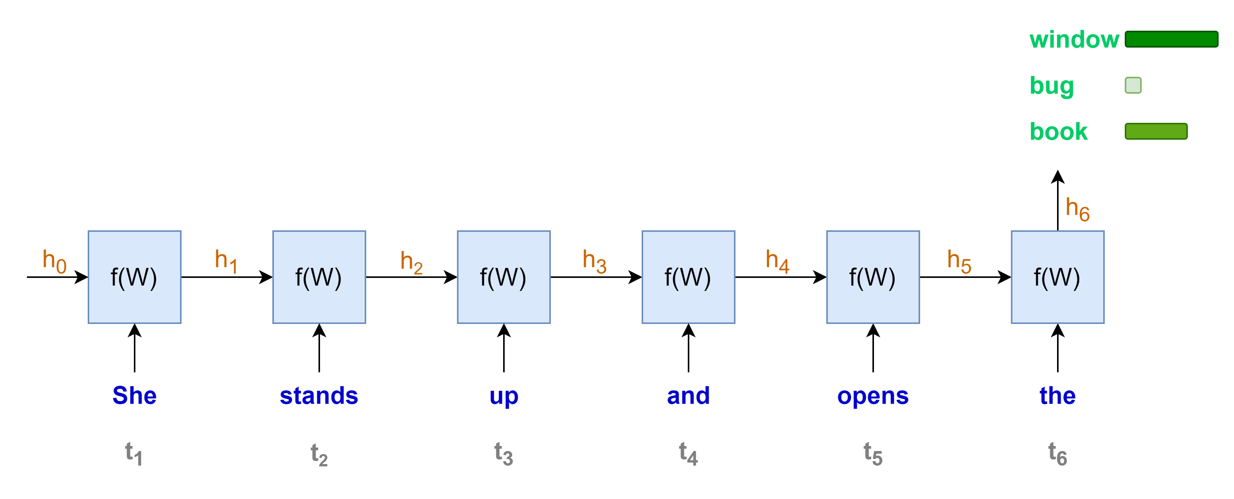
Some Disadvantages of RNNs (1/3)
Sequential computation, one word at a time
Less rooms for parallel computation
Longer sequence, longer computation time
“She stands up and opens the …”

Slide 8
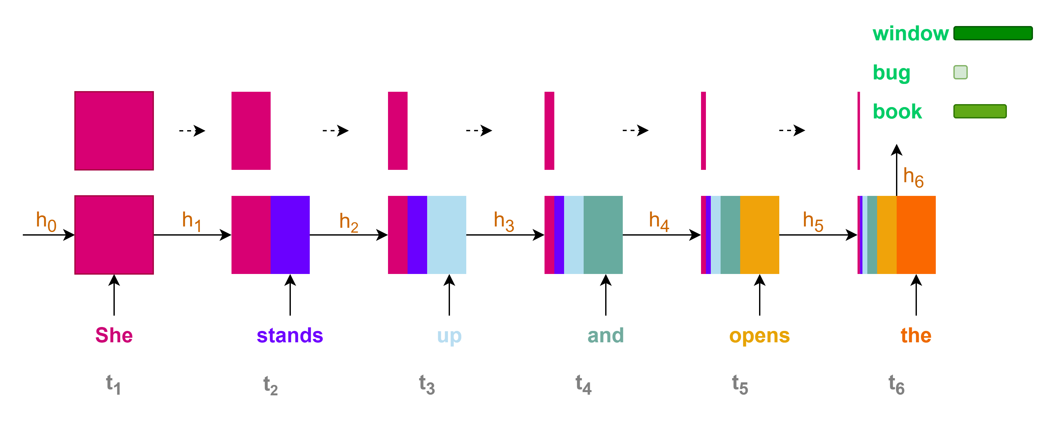
Some Disadvantages of RNNs (2/3)
Contributions of initial states or information to the final state or prediction are very small for long sequence context
Loss of information for long-range dependencies

Slide 9
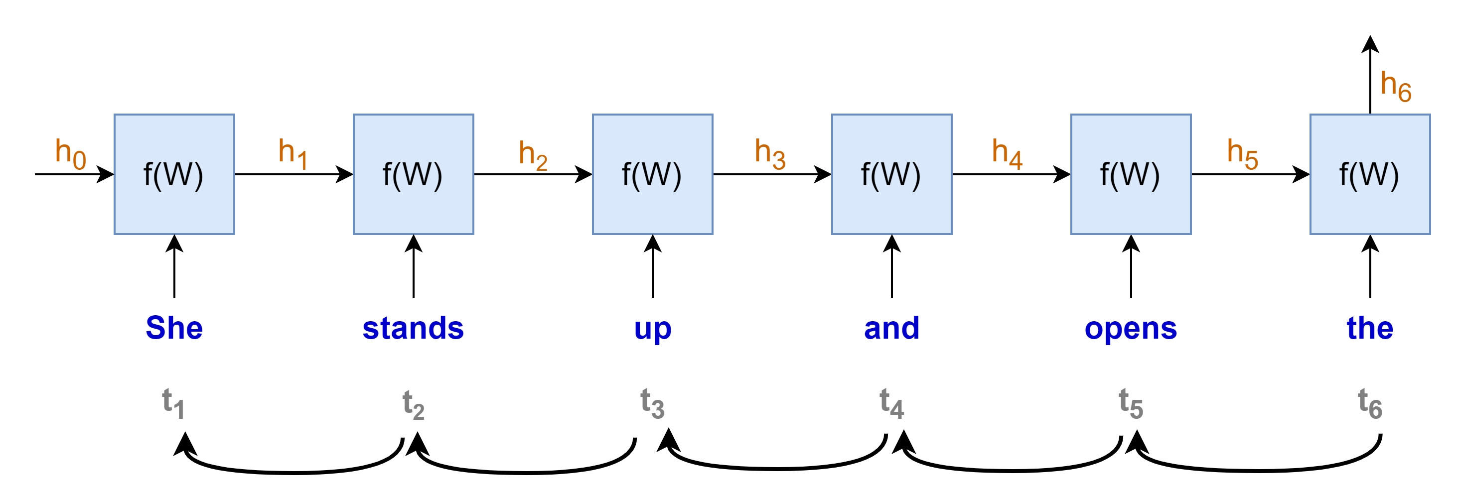
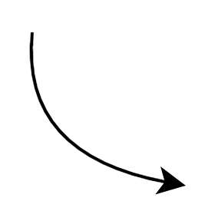
















Some Disadvantages of RNNs (3/3)
Training with Backpropagation Through Time
Vanishing or exploding gradients problems
hindering the learning process, especially for long sequences
making the training process highly unstable
$$gradient products$$
$$\frac{∂h_{t}}{∂h_{t−1}}≪1 →very small→"vanished"$$
$$\frac{∂h_{t}}{∂h_{t−1}}≫1 →very large→"exploded"$$
$$\frac{∂h_{1}}{∂W}$$
$$\frac{∂h_{2}}{∂h_{1}}$$
$$\frac{∂h_{3}}{∂h_{2}}$$
$$\frac{∂h_{4}}{∂h_{3}}$$
$$\frac{∂h_{5}}{∂h_{4}}$$
$$\frac{∂h_{6}}{∂h_{5}}$$
$$×$$
$$×$$
$$×$$
$$×$$
$$×$$
$$\frac{∂L}{∂W}=\frac{∂L}{∂y}\frac{∂y}{∂h_{6}}$$
$$×$$
“chain rule”

Slide 10
Some Disadvantages of RNNs
Sequential computation, hard to parallel computation with GPU
Loss of information for long-term dependencies
Vanishing or exploding gradient problems
2017
RNNs

Slide 11
The Arrival of Transformer
2017
RNNs
Transformer
"Attention Is All You Need"

Slide 12


Transformer for machine translation
Prediction
"Je vais bien"
Transformer
Decoder
Encoder
Source
"I am fine"
Simplified transformer architecture

Slide 13
RNNs vs Transformers
RNNs with their limitations
Transformers with self-attention
Sequential computation, hard to parallel computation with GPU
Loss of information for long-term dependencies
Vanishing or exploding gradient problems
Parallel computation
Leveraging GPU
Capture long-range dependencies
Less prone to vanishing or exploding gradient

Slide 14
NLP After Transformer's Arrival in 2017
Pre-Trained Languages Models
BERT
GPT
T5
Llama
Mistral
Phi
Falcon
Qwen
Gemma
2017
2018
RNNs
Transformer
Pre-trained Language Models

Slide 15
Mastering Transformer's Block-by-Block

Slide 16
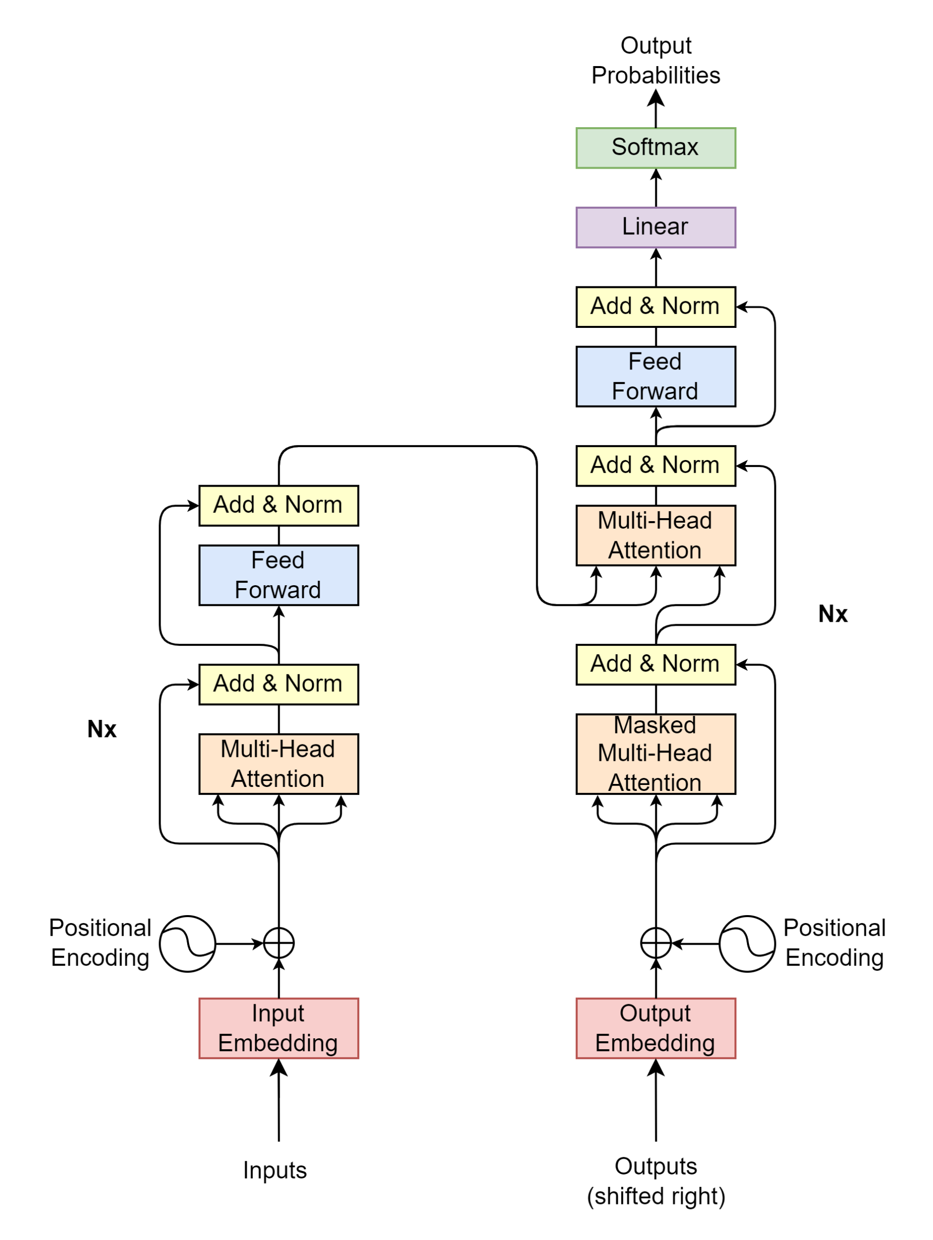
Transformer Block-by-Block
How does the model understand text data?
What are the input, output, and process of each block?
Projection
Decoder
Encoder
Encoder Input
Decoder Input

Slide 17
Inputs / Outputs

Slide 18

Inputs / Outputs

Slide 19
Inputs / Outputs
Inputs
Outputs
Source
Target/Label
"I
am
fine"
"Thank
you
very
much"
"Je vais bien"
"Merci beaucoup"

Slide 20
Inputs / Outputs
Inputs
Outputs
Source
Target/Label
The model only understands numerical values
→ Transform text into numerical representation.
Source and target texts may have different lengths
→ A fixed sequence length is needed for model computation.
When to start and end the model’s prediction
→ Find ways to notify the model when to start and end the prediction
"I
am
fine"
"Thank
you
very
much"
"Je vais bien"
"Merci beaucoup"

Slide 21
Inputs/Outputs
Inputs
Outputs
Source
Target/Label
The model only understands numerical values
→ Transform text into numerical representation.
Source and target texts may have different lengths
→ A fixed sequence length is needed for model computation.
When to start and end the model’s prediction
→ Find ways to notify the model when to start and end the prediction
"I
am
fine"
"Thank
you
very
much"
"Je vais bien"
"Merci beaucoup"
Tokenizer
2
9
107
550
3
1
1
2
2089
95
75
120
3
1
2
69
600
71
3
1
1
2
3546
324
3
1
1
1

Slide 22
Tokenizer

Slide 23
Tokenizer
Contains a large vocabulary dictionary
Transforms text to numerical representation
A token can be a word or a character
Special tokens
UNK: Unknown
PAD: Padding
SOS: Start Of Sentence
EOS: End Of Sentence
{
…
"vocab": {
"[UNK]": 0,
"[PAD]": 1,
"[SOS]": 2,
"[EOS]": 3,
"I" : 9,
"you": 24,
"very": 75,
"am" : 107,
"much": 120,
"fine": 550,
"French": 582
"cook": 1779,
"Thank": 2089,
}
…
}

Slide 24
Tokenizer
Tokenizer
"I
am
fine"
encodes
9
107
550
decodes
"I
am
fine"

Slide 25
Inputs / Outputs Put it all together

Slide 26

Put it all together (1/3)
Source (max length: 4)
"I am fine"
"Thank you very much"
"I cook French cuisine"
Fixed length, SOS, EOS
For Inputs
SOS
I
am
fine
EOS
PAD
PAD
SOS
Thank
you
very
much
EOS
PAD
SOS
I
cook
French
cuisine
EOS
PAD
2
9
107
550
3
1
1
2
2089
95
75
120
3
1
2
9
1779
582
0
3
1
$seq$=7
Source tokenizer
encodes

Slide 27
Put it all together (2/3)
Target (max length: 5)
"Je vais bien"
"Merci beaucoup"
"Je fais la cuisine française"
Fixed length, SOS, EOS
For Outputs (shifted right)
SOS
Je
vais
bien
PAD
PAD
PAD
SOS
Merci
beaucoup
PAD
PAD
PAD
PAD
SOS
Je
fais
la
cuisine
française
PAD
2
69
600
71
1
1
1
2
3546
324
1
1
1
1
2
69
1355
9
1390
5309
1
$seq$=7
Target tokenizer
encodes

Slide 28
Put it all together (3/3)
Target
Loss
Target (max length: 5)
"Je vais bien"
"Merci beaucoup"
"Je fais la cuisine française"
Fixed length, SOS, EOS
For Target in loss computation
Je
vais
bien
EOS
PAD
PAD
PAD
Merci
beaucoup
EOS
PAD
PAD
PAD
PAD
Je
fais
la
cuisine
française
EOS
PAD
69
600
71
3
1
1
1
3546
324
3
1
1
1
1
69
1355
9
1390
5309
3
1
$seq$=7
Target tokenizer
encodes

Slide 29
Encoder / Decoder Inputs

Slide 30
Encoder / Decoder Inputs
Projection
Decoder
Encoder
Encoder Input
Decoder Input

Slide 31


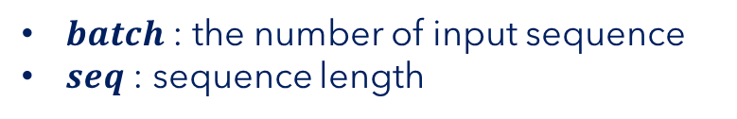

Encoder Input
Positional
Encoding
$batch$ : the number of input sequence
$seq$ : sequence length
Input Embedding
Inputs
$$\left(batch, seq\right)$$
2
9
107
550
3
1
1
"I
am
fine"
tokenizer
encodes
$$seq$$

Slide 32

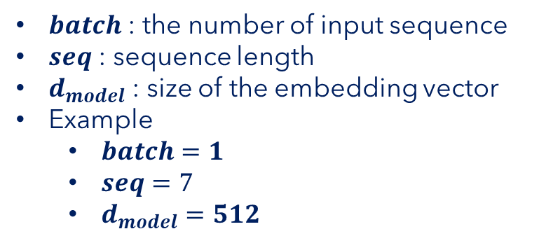

Encoder Input
Positional
Encoding
$batch$ : the number of input sequence
$seq$ : sequence length
$d_{model}$ : size of the embedding vector
Example
$batch=1$
$seq=7$
$d_{model}=512$
$$\left(batch, seq, d_{model}\right)$$
$$\left(batch, seq, d_{model}\right)$$
Input Embedding
Inputs
$$\left(batch, seq\right)$$
2
9
107
550
3
1
1
"I
am
fine"
tokenizer
encodes
$$seq$$

Slide 33


Encoder Input
Encoder Input
Positional
Encoding
$$\left(batch, seq, d_{model}\right)$$
$batch$ : the number of input sequence
$seq$ : sequence length
$d_{model}$ : size of the embedding vector
Example
$batch=1$
$seq=7$
$d_{model}=512$
$$\left(batch, seq, d_{model}\right)$$
$$\left(batch, seq, d_{model}\right)$$
Input Embedding
Inputs
$$\left(batch, seq\right)$$
2
9
107
550
3
1
1
"I
am
fine"
tokenizer
encodes
$$seq$$

Slide 34
Input Embedding

Slide 35
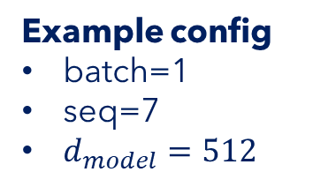
Input Embedding
Example config
batch=1
seq=7
$d_{model}=512$
$$\left(batch, seq, d_{model}\right)$$
Input Embedding
Inputs
$$\left(batch, seq\right)$$
2
9
107
550
3
1
1
"I
am
fine"
tokenizer
encodes
$$seq$$

Slide 36


Input Embedding
$$d_{model}$$
… | … | … | … | …
523.415 | 1265.142 | … | 4189.251 | 16.416
452.716 | 6234.624 | … | 412.414 | 1794.127
7745.984 | 1314.124 | … | 65.764 | 1543.345
… | … | … | … | …
… | … | … | … | …
… | … | … | … | …
$$seq$$
Example config
batch=1
seq=7
$d_{model}=512$
$$\left(batch, seq, d_{model}\right)$$
Input Embedding
Inputs
$$\left(batch, seq\right)$$
2
9
107
550
3
1
1
"I
am
fine"
tokenizer
encodes
$$seq$$

Slide 37
Positional Encoding

Slide 38
Positional Encoding
Encoder Input
Positional
Encoding
$$\left(batch, seq, d_{model}\right)$$
Example config
batch=1
seq=7
$d_{model}=512$
$$\left(batch, seq, d_{model}\right)$$
$$\left(batch, seq, d_{model}\right)$$
Input Embedding
Inputs
$$\left(batch, seq\right)$$
2
9
107
550
3
1
1
"I
am
fine"
tokenizer
encodes
$$seq$$

Slide 39


Positional Encoding
Example config
batch=1
seq=7
$d_{model}=512$
$$\left(batch, seq, d_{model}\right)$$
Positional
Encoding
Inputs
$$\left(batch, seq\right)$$
2
9
107
550
3
1
1
"I
am
fine"
tokenizer
encodes
$$seq$$

Slide 40





Positional Encoding
$$d_{model}$$
… | … | … | … | …
PE(1,0) | PE(1,1) | … | PE(1,510) | PE(1, 511)
PE(2,0) | PE(2,1) | … | PE(2,510) | PE(2, 511)
PE(3,0) | PE(3,1) | … | PE(3,510) | PE(3, 511)
… | … | … | … | …
… | … | … | … | …
… | … | … | … | …
$$pos=0$$
$pos=$1
$$⋮$$
$$seq$$
Example config
batch=1
seq=7
$d_{model}=512$
$$pos$$
$$=seq−1$$
$$\left(batch, seq, d_{model}\right)$$
Positional
Encoding
Inputs
$$\left(batch, seq\right)$$
2
9
107
550
3
1
1
"I
am
fine"
tokenizer
encodes
$$seq$$

Slide 41


Positional Encoding
$$d_{model}$$
… | … | … | … | …
PE(1,0) | PE(1,1) | … | PE(1,510) | PE(1, 511)
PE(2,0) | PE(2,1) | … | PE(2,510) | PE(2, 511)
PE(3,0) | PE(3,1) | … | PE(3,510) | PE(3, 511)
… | … | … | … | …
… | … | … | … | …
… | … | … | … | …
$$pos=0$$
$pos=$1
$$⋮$$
$$seq$$
Example config
batch=1
seq=7
$d_{model}=512$
$$pos$$
$$=seq−1$$
$$\left(batch, seq, d_{model}\right)$$
PE$\left(pos, 2i\right)=\sin\left(\frac{pos}{{10000}^{\frac{2i}{d_{model}}}}\right)$
Positional
Encoding
PE$\left(pos, 2i+1\right)=\cos\left(\frac{pos}{{10000}^{\frac{2i}{d_{model}}}}\right)$
Inputs
$$\left(batch, seq\right)$$
2
9
107
550
3
1
1
"I
am
fine"
tokenizer
encodes
$$seq$$

Slide 42


Positional Encoding
$$d_{model}$$
… | … | … | … | …
PE(1,0) | PE(1,1) | … | PE(1,510) | PE(1, 511)
PE(2,0) | PE(2,1) | … | PE(2,510) | PE(2, 511)
PE(3,0) | PE(3,1) | … | PE(3,510) | PE(3, 511)
… | … | … | … | …
… | … | … | … | …
… | … | … | … | …
$$pos=0$$
$pos=$1
$$⋮$$
$$seq$$
Example config
batch=1
seq=7
$d_{model}=512$
$$pos$$
$$=seq−1$$
$$\left(batch, seq, d_{model}\right)$$
PE$\left(pos, 2i\right)=\sin\left(\frac{pos}{{10000}^{\frac{2i}{d_{model}}}}\right)$
Positional
Encoding
PE$\left(pos, 2i+1\right)=\cos\left(\frac{pos}{{10000}^{\frac{2i}{d_{model}}}}\right)$
Inputs
$$\left(batch, seq\right)$$
2
9
107
550
3
1
1
"I
am
fine"
tokenizer
encodes
$$seq$$

Slide 43
Positional Encoding
$$d_{model}$$
… | … | … | … | …
PE(1,0) | PE(1,1) | … | PE(1,510) | PE(1, 511)
PE(2,0) | PE(2,1) | … | PE(2,510) | PE(2, 511)
PE(3,0) | PE(3,1) | … | PE(3,510) | PE(3, 511)
… | … | … | … | …
… | … | … | … | …
… | … | … | … | …
$$pos=0$$
$pos=$1
$$⋮$$
$$seq$$
Example config
batch=1
seq=7
$d_{model}=512$
$$pos$$
$$=seq−1$$
$$\left(batch, seq, d_{model}\right)$$
PE$\left(pos, 2i\right)=\sin\left(\frac{pos}{{10000}^{\frac{2i}{d_{model}}}}\right)$
Positional
Encoding
PE$\left(pos, 2i+1\right)=\cos\left(\frac{pos}{{10000}^{\frac{2i}{d_{model}}}}\right)$
Inputs
$$\left(batch, seq\right)$$
2
9
107
550
3
1
1
"I
am
fine"
tokenizer
encodes
$$seq$$

Slide 44
Encoder / Decoder Inputs Put it all together

Slide 45
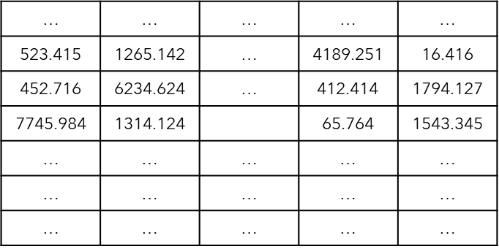
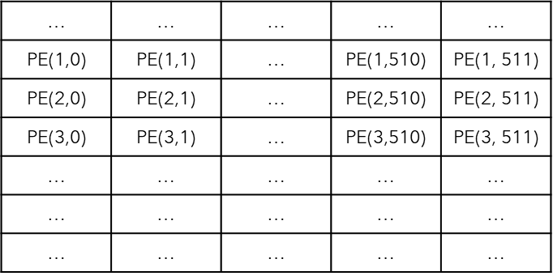




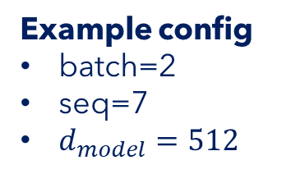





Encoder Input | Put it all together
Encoder Input
Example config
batch=2
seq=7
$d_{model}=512$
Positional
Encoding
$$\left(batch, seq, d_{model}\right)$$
$$d_{model}$$
$$\left(batch, seq, d_{model}\right)$$
$$\left(batch, seq, d_{model}\right)$$
$$seq$$
Input Embedding
$$batch$$
Inputs
$$\left(batch, seq\right)$$
2
9
107
550
3
1
1
2
2089
95
75
120
3
1
$$batch$$
"I
am
fine"
"Thank
you
very
much"
$$seq$$

Slide 46
Encoder

Slide 47
Encoder
Projection
Decoder
Encoder
Encoder Input
Decoder Input

Slide 48
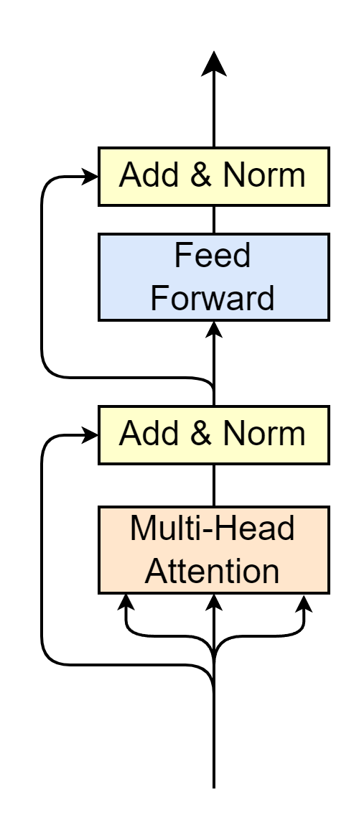
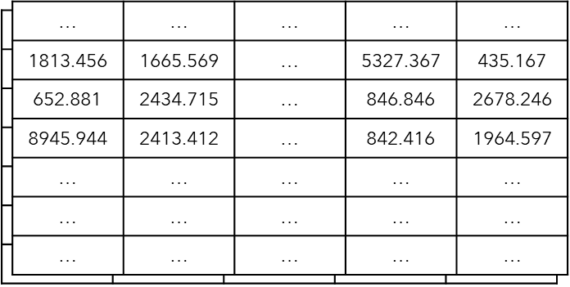



Encoder
Encoder Output
$$\left(batch, seq, d_{model}\right)$$
Multi-Head Attention
Self-Attention
Layer Normalization
Feed Forward
Residual connection
Residual Connection
$$N_{x}$$
Encoder Input
"Word meaning + position feature"
$$\left(batch, seq, d_{model}\right)$$

Slide 49
Multi-Head Attention | Self Attention

Slide 50
Multi-Head Attention
Encoder Output
$$\left(batch, seq, d_{model}\right)$$
$$N_{x}$$
Encoder Input
$$\left(batch, seq, d_{model}\right)$$

Slide 51
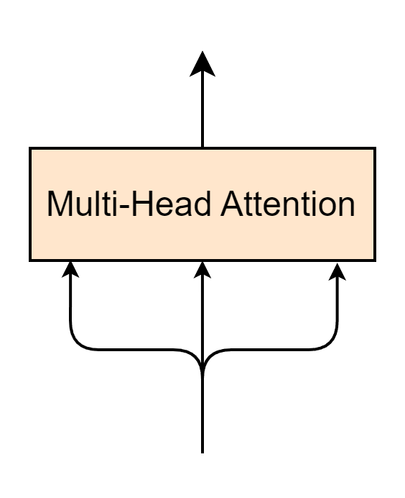








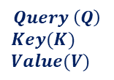
Multi-Head Attention
$$\left(batch, seq, d_{model}\right)$$
$$Q$$
$$K$$
$$V$$
Encoder Input
$$Query \left(Q\right)$$
$$Key(K)$$
$$Value(V)$$
$$\left(batch, seq, d_{model}\right)$$
$$seq$$
$$≡$$
$$batch$$
$$d_{model}$$
"Word meaning + position feature"

Slide 52
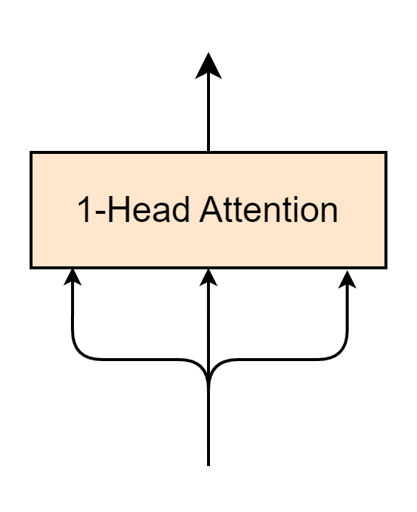
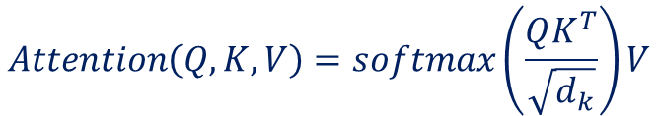
1-Head Attention Layer
$$\left(batch, seq, d_{model}\right)$$
$$Attention\left(Q, K, V\right)=softmax\left(\frac{QK^{T}}{\sqrt{d_{k}}}\right)V$$
$$Q$$
$$K$$
$$V$$
Encoder Input
$$\left(batch, seq, d_{model}\right)$$

Slide 53
Self Attention
Self-Attention
$$\left(batch, seq, d_{model}\right)$$
$$Attention\left(Q, K, V\right)=softmax\left(\frac{QK^{T}}{\sqrt{d_{k}}}\right)V$$
$$Q$$
$$K$$
$$V$$
Encoder Input
$$\left(batch, seq, d_{model}\right)$$

Slide 54

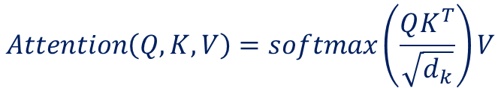






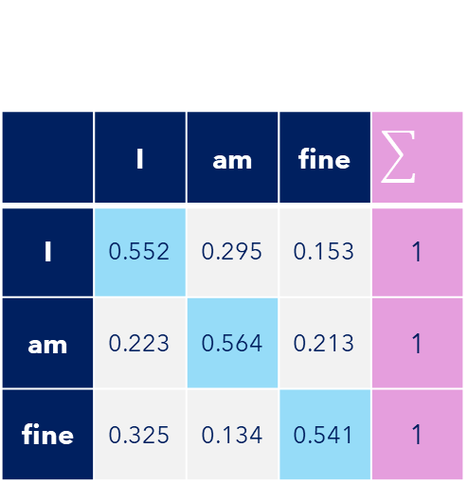

Self-Attention
Self-Attention
Example config
batch=1
seq=3
$d_{model}=d_{k}=512$
$$Attention\left(Q, K, V\right)=softmax\left(\frac{QK^{T}}{\sqrt{d_{k}}}\right)V$$
$$K^{T}(512,3)$$
$$Q(3, 512)$$
1813.456 | 652.881 | 8945.944
1665.569 | 2434.715 | 2413.412
… | … | …
5327.367 | 846.846 | 842.416
435.167 | 2678.246 | 1964.597
Self-Attention$(3,3)$
1813.456 | 1665.569 | … | 5327.367 | 435.167
652.881 | 2434.715 | … | 846.846 | 2678.246
8945.944 | 2413.412 | … | 842.416 | 1964.597
$$×$$
 | I | am | fine
I | 0.552 | 0.295 | 0.153 | 1
am | 0.223 | 0.564 | 0.213 | 1
fine | 0.325 | 0.134 | 0.541 | 1
$$softmax$$
$$=$$
$$\sqrt{512}$$
Self-attention -> Words to relate to each other

Slide 55






1-Head Attention
1-Head Attention
Self-Attention
Example config
batch=1
seq=3
$d_{model}=d_{k}=512$
$$Attention\left(Q, K, V\right)=softmax\left(\frac{QK^{T}}{\sqrt{d_{k}}}\right)V$$
Self-Attention$(3,3)$
 | I | am | fine
I | 0.552 | 0.295 | 0.153 | 1
am | 0.223 | 0.564 | 0.213 | 1
fine | 0.325 | 0.134 | 0.541 | 1
V$(3, 512)$
Attention$(3, 512)$
1813.456 | 1665.569 | … | 5327.367 | 435.167
652.881 | 2434.715 | … | 846.846 | 2678.246
8945.944 | 2413.412 | … | 842.416 | 1964.597
… | … | … | … | …
… | … | … | … | …
… | … | … | … | …
$$×$$
$$=$$
"Word meaning + position feature"
"Word meaning + position feature"
"Relate words to each other"
"Relate words to each other"

Slide 56
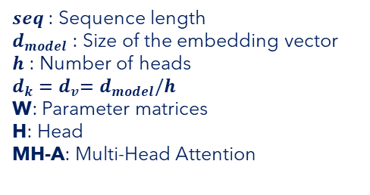
Multi-Head Attention
$seq$ : Sequence length
$d_{model}$ : Size of the embedding vector
$h$ : Number of heads
$d_{k}{=d}_{v}=d_{model}/h$
W: Parameter matrices
H: Head
MH-A: Multi-Head Attention

Slide 57
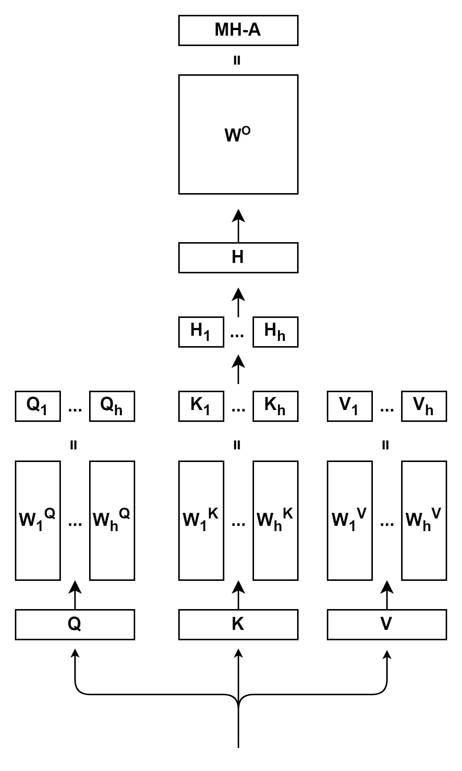
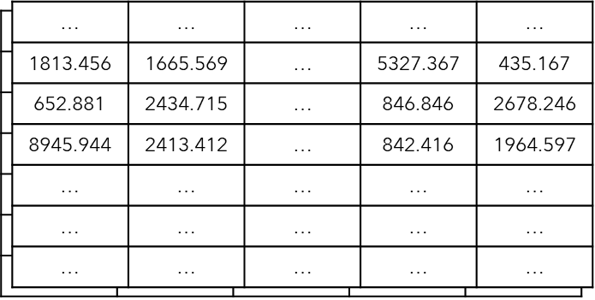

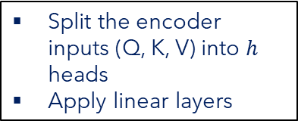


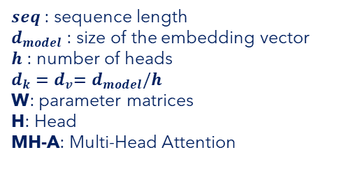



Multi-Head Attention
$seq$ : sequence length
$d_{model}$ : size of the embedding vector
$h$ : number of heads
$d_{k}{=d}_{v}=d_{model}/h$
W: parameter matrices
H: Head
MH-A: Multi-Head Attention
$$\left(batch, seq, d_{k}\right)$$
$$×$$
$$\left(batch,d_{model}, d_{k}\right)$$
Split the encoder inputs (Q, K, V) into $h$ heads
Apply linear layers
$$batch$$
$$d_{model}$$
$$\left(batch, seq, d_{model}\right)$$
$$seq$$
Encoder Input
$$\left(batch, seq, d_{model}\right)$$

Slide 58


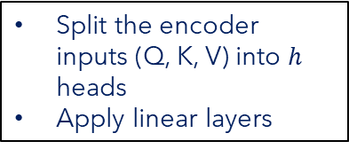

Multi-Head Attention
$seq$ : sequence length
$d_{model}$ : size of the embedding vector
$h$ : number of heads
$d_{k}{=d}_{v}=d_{model}/h$
W: parameter matrices
H: Head
MH-A: Multi-Head Attention
$$\left(batch, seq, d_{v}\right)$$
$${Head}_{i}=Attention\left(QW_{i}^{Q},KW_{i}^{K},VW_{i}^{V}\right)$$
$$Attention\left(Q, K, V\right)=softmax\left(\frac{QK^{T}}{\sqrt{d_{k}}}\right)V$$
$$\left(batch, seq, d_{k}\right)$$
$$×$$
$$\left(batch,d_{model}, d_{k}\right)$$
Split the encoder inputs (Q, K, V) into $h$ heads
Apply linear layers
$$batch$$
$$d_{model}$$
$$\left(batch, seq, d_{model}\right)$$
$$seq$$
Encoder Input
$$\left(batch, seq, d_{model}\right)$$

Slide 59


Multi-Head Attention
$seq$ : sequence length
$d_{model}$ : size of the embedding vector
$h$ : number of heads
$d_{k}{=d}_{v}=d_{model}/h$
W: parameter matrices
H: Head
MH-A: Multi-Head Attention
$$\left(batch, seq, d_{model}\right)$$
$$Concat\left(head_{1},⋯,head_{h}\right)$$
$$\left(batch, seq, d_{v}\right)$$
$${Head}_{i}=Attention\left(QW_{i}^{Q},KW_{i}^{K},VW_{i}^{V}\right)$$
$$Attention\left(Q, K, V\right)=softmax\left(\frac{QK^{T}}{\sqrt{d_{k}}}\right)V$$
$$\left(batch, seq, d_{k}\right)$$
$$×$$
$$\left(batch,d_{model}, d_{k}\right)$$
Split the encoder inputs (Q, K, V) into $h$ heads
Apply linear layers
$$batch$$
$$d_{model}$$
$$\left(batch, seq, d_{model}\right)$$
$$seq$$
Encoder Input
$$\left(batch, seq, d_{model}\right)$$

Slide 60



Multi-Head Attention
$$\left(batch, seq, d_{model}\right)$$
$seq$ : sequence length
$d_{model}$ : size of the embedding vector
$h$ : number of heads
$d_{k}{=d}_{v}=d_{model}/h$
W: parameter matrices
H: Head
MH-A: Multi-Head Attention
$$×$$
$$\left(batch,d_{model}, d_{model}\right)$$
Apply a linear layer
$$\left(batch, seq, d_{model}\right)$$
$$Concat\left(head_{1},⋯,head_{h}\right)$$
$$\left(batch, seq, d_{v}\right)$$
$${Head}_{i}=Attention\left(QW_{i}^{Q},KW_{i}^{K},VW_{i}^{V}\right)$$
$$Attention\left(Q, K, V\right)=softmax\left(\frac{QK^{T}}{\sqrt{d_{k}}}\right)V$$
$$\left(batch, seq, d_{k}\right)$$
$$×$$
$$\left(batch,d_{model}, d_{k}\right)$$
Split the encoder inputs (Q, K, V) into $h$ heads
Apply linear layers
$$batch$$
$$d_{model}$$
$$\left(batch, seq, d_{model}\right)$$
$$seq$$
Encoder Input
$$\left(batch, seq, d_{model}\right)$$

Slide 61
Layer Normalization

Slide 62

Layer Normalization
Encoder Output
$$\left(batch, seq, d_{model}\right)$$
$$N_{x}$$
Encoder Input
$$\left(batch, seq, d_{model}\right)$$

Slide 63
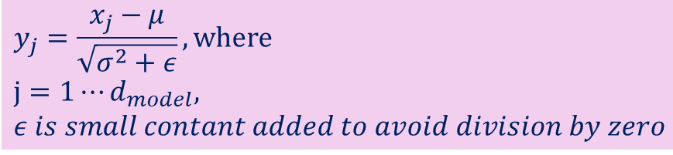

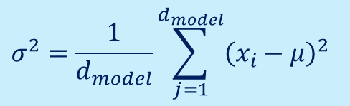
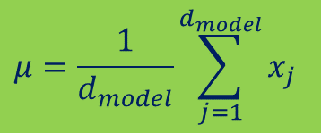




Layer Normalization
Given a feature vector of a token, having length of $d_{model}$
Calculate mean
Calculate variance
Normalization
$$x_{1}$$
$$x_{d_{model}}$$
 |  | …
$$μ=\frac{1}{d_{model}}\sum_{j=1}^{d_{model}}{x_{j}}$$
$$σ^{2}=\frac{1}{d_{model}}\sum_{j=1}^{d_{model}}{{\left(x_{i}−μ\right)}^{2}}$$
$$y_{j}=\frac{x_{j}−μ}{\sqrt{σ^{2}+ε}}, where$$
$$j=1⋯d_{model},$$
$ε is small contant added to avoid division by zero$
$$y_{1}$$
$$y_{d_{model}}$$
 |  | …

Slide 64
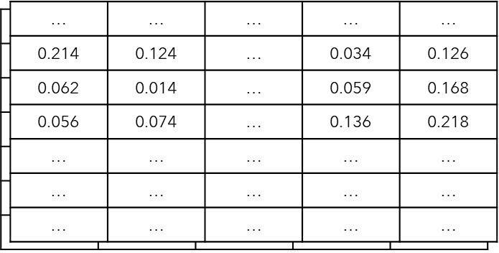
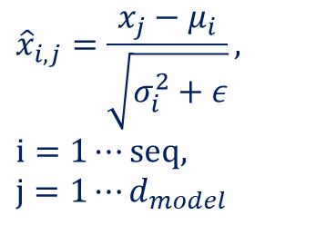


Layer Normalization
$$\left(batch, seq,d_{model}\right)$$
$${\hat{x}}_{i,j}=\frac{x_{j}−μ_{i}}{\sqrt{σ_{i}^{2}+ε}},$$
$$i=1⋯seq,$$
$$j=1⋯d_{model}$$
Layer Normalization
$$\left(batch, seq,d_{model}\right)$$
$$batch$$
$$seq$$
$$d_{model}$$

Slide 65
Feed Forward

Slide 66
Feed Forward
Encoder Output
$$\left(batch, seq, d_{model}\right)$$
$$N_{x}$$
Encoder Input
$$\left(batch, seq, d_{model}\right)$$

Slide 67
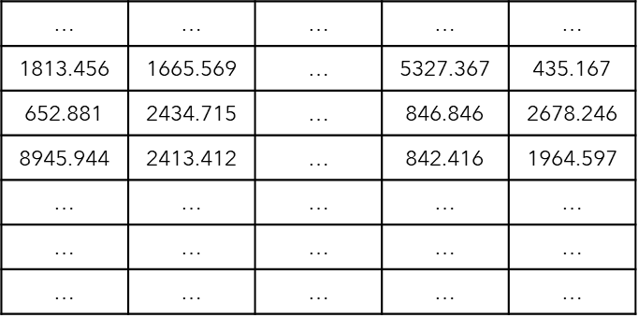


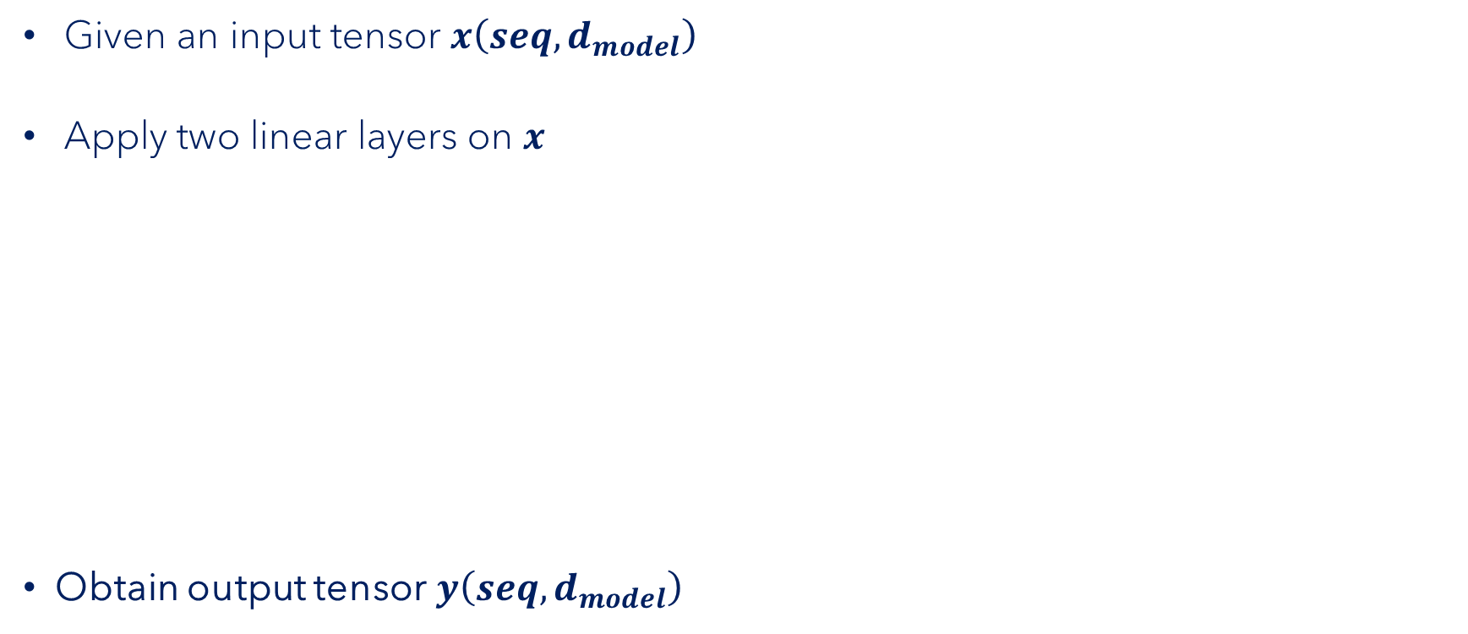








Feed Forward
$$seq$$
Given an input tensor $x\left(seq,d_{model}\right)$
Apply two linear layers on $x$
Obtain output tensor$y\left(seq,d_{model}\right)$
$$d_{model}$$
$$W_{1}$$
$$x$$
$$×$$
$$+$$
$$b_{1}$$
$$\left(seq,d_{model}\right)$$
$$\left(d_{model},d_{ff}\right)$$
$$Linear layer 1 \left(seq,d_{ff}\right)$$

Slide 68

Feed Forward
$$seq$$
Given an input tensor $x\left(seq,d_{model}\right)$
Apply two linear layers on $x$
Obtain output tensor$y\left(seq,d_{model}\right)$
$$d_{model}$$
$$W_{1}$$
$$x$$
$$×$$
$$+$$
$$b_{1}$$
$$ReLU$$
$$\left(seq,d_{model}\right)$$
$$\left(d_{model},d_{ff}\right)$$
$$Linear layer 1 \left(seq,d_{ff}\right)$$

Slide 69







Feed Forward
$$seq$$
Given an input tensor $x\left(seq,d_{model}\right)$
Apply two linear layers on $x$
Obtain output tensor$y\left(seq,d_{model}\right)$
$$d_{model}$$
$$y=FF\left(x\right)=ReLU\left(x{×W}_{1}+b_{1}\right)×W_{2}+b_{2} , where ReLU\left(x\right)=max(0,x)$$
$$W_{1}$$
$$W_{2}$$
$$FF\left(x\right)=$$
$$x$$
$$×$$
$$+$$
$$b_{1}$$
$$×$$
$$+$$
$$b_{2}$$
$$ReLU$$
$$\left(seq,d_{model}\right)$$
$$\left(d_{ff},d_{model}\right)$$
$$\left(d_{model},d_{ff}\right)$$
$$Linear layer 1 \left(seq,d_{ff}\right)$$
$$Linear layer 2 \left(seq,d_{model}\right)$$

Slide 70
Residual Connection

Slide 71
Residual Connection
Encoder Output
$$\left(batch, seq, d_{model}\right)$$
Residual Connection
$$N_{x}$$
Encoder Input
$$\left(batch, seq, d_{model}\right)$$

Slide 72


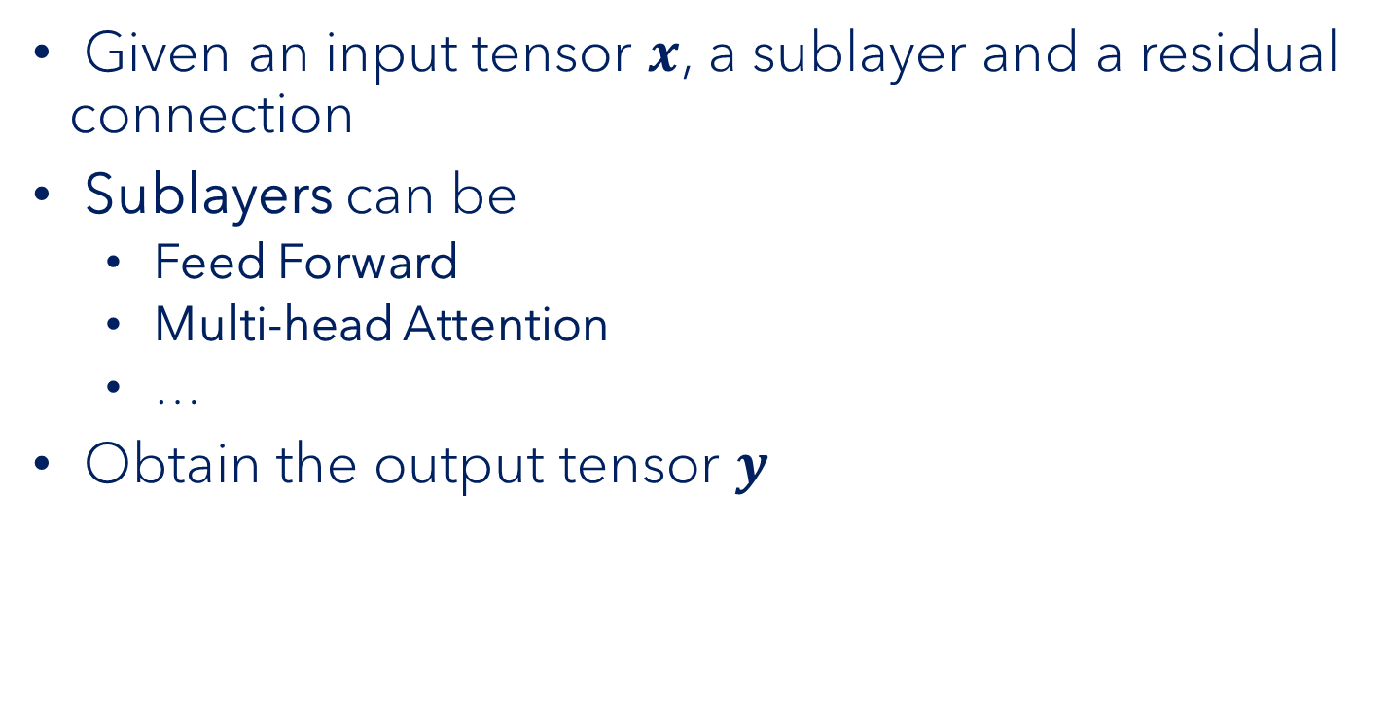



Residual Connection
$$y$$
$$+$$
Given an input tensor $x$, a sublayer and a residual connection
Sublayers can be
Feed Forward
Multi-head Attention
…
Obtain the output tensor $y$
$$Sublayer$$
$$x$$
$$y =x+sublayer(x)$$

Slide 73
Encoder | Put it all together

Slide 74

Encoder | Put it all together
Encoder Output
$$\left(batch, seq, d_{model}\right)$$
Multi-Head Attention
Self-Attention
Layer Normalization
Feed Forward
Residual connection
Residual Connection
$N_{x}$=6
Encoder Input
$$\left(batch, seq, d_{model}\right)$$

Slide 75
Decoder

Slide 76
Decoder
Projection
Decoder
Encoder
Encoder Input
Decoder Input

Slide 77
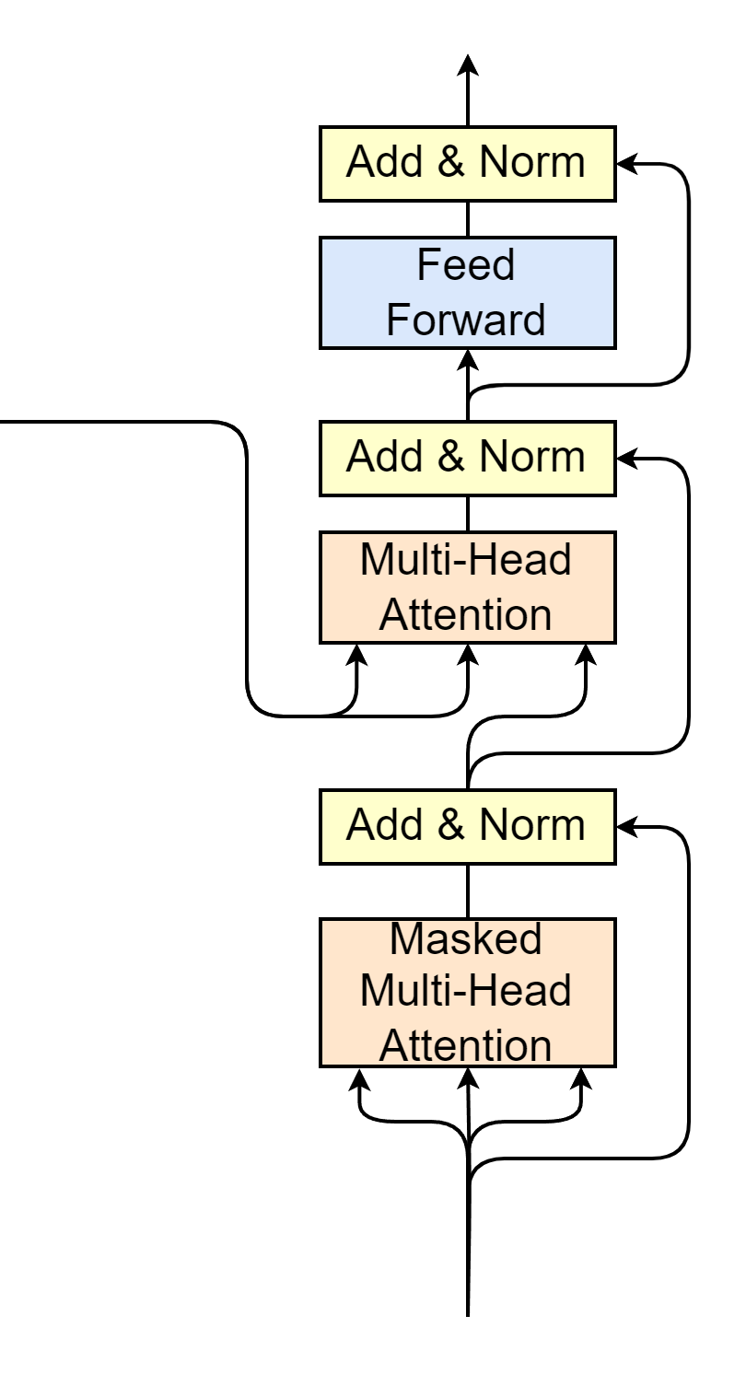

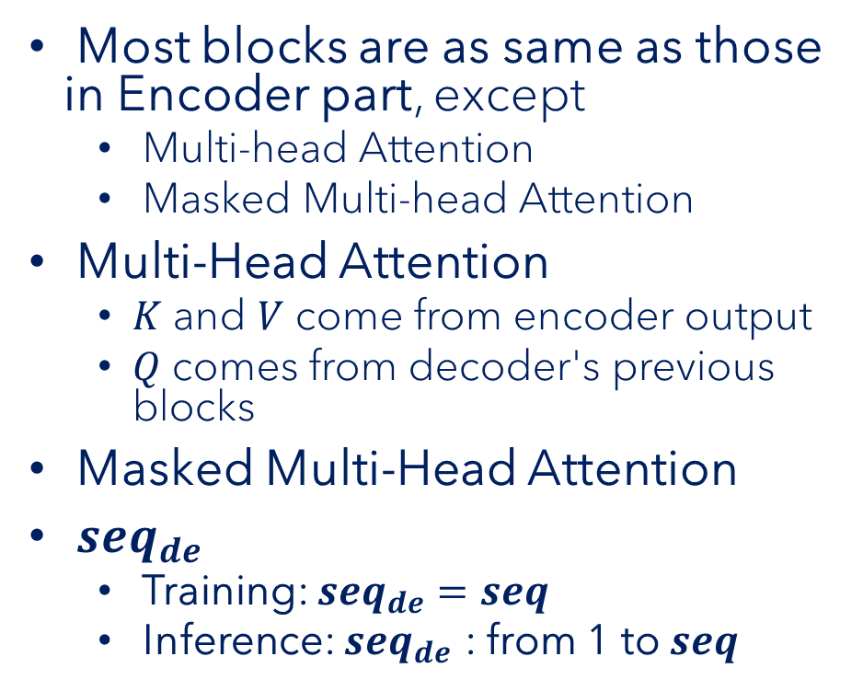







Decoder
Decoder Input
$$\left(batch, seq_{de}, d_{model}\right)$$
Most blocks are as same as those in Encoder part, except
Multi-head Attention
Masked Multi-head Attention
Multi-Head Attention
$K$ and $V$ come from encoder output
$Q$ comes from decoder's previous blocks
Masked Multi-Head Attention
$seq_{de}$
Training: $seq_{de}=seq$
Inference: $seq_{de}$ : from 1 to $seq$
Encoder Output
$$\left(batch, seq, d_{model}\right)$$
$$K$$
$$V$$
$$Q$$
$$N_{x}$$
$$\left(batch, seq_{de}, d_{model}\right)$$
Decoder Input
$$\left(batch, seq_{de}, d_{model}\right)$$

Slide 78
Masked Multi-Head Attention

Slide 79


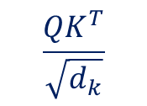
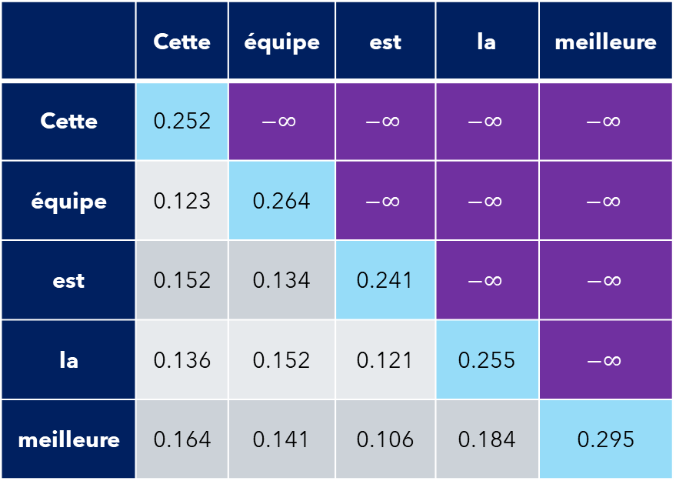
Masked Multi-Head Attention
$$Attention\left(Q, K, V\right)=softmax\left(\frac{QK^{T}}{\sqrt{d_{k}}}\right)V$$
Self-attention
$$\frac{QK^{T}}{\sqrt{d_{k}}}$$
Apply mask matrix
Each word only correlates with previous words
 | Cette | équipe | est | la | meilleure
Cette | 0.252 | $$−∞$$ | $$−∞$$ | $$−∞$$ | $$−∞$$
équipe | 0.123 | 0.264 | $$−∞$$ | $$−∞$$ | $$−∞$$
est | 0.152 | 0.134 | 0.241 | $$−∞$$ | $$−∞$$
la | 0.136 | 0.152 | 0.121 | 0.255 | $$−∞$$
meilleure | 0.164 | 0.141 | 0.106 | 0.184 | 0.295
 | Cette | équipe | est | la | meilleure
Cette | 1.0 | 0 | 0 | 0 | 0
équipe | 0.465 | 0.525 | 0 | 0 | 0
est | 0.325 | 0.319 | 0.356 | 0 | 0
la | 0.242 | 0.246 | 0.239 | 0.273 | 0
meilleure | 0.197 | 0.192 | 0.186 | 0.201 | 0.224
$$softmax$$

Slide 80
Multi-Head Attention for Decoder

Slide 81
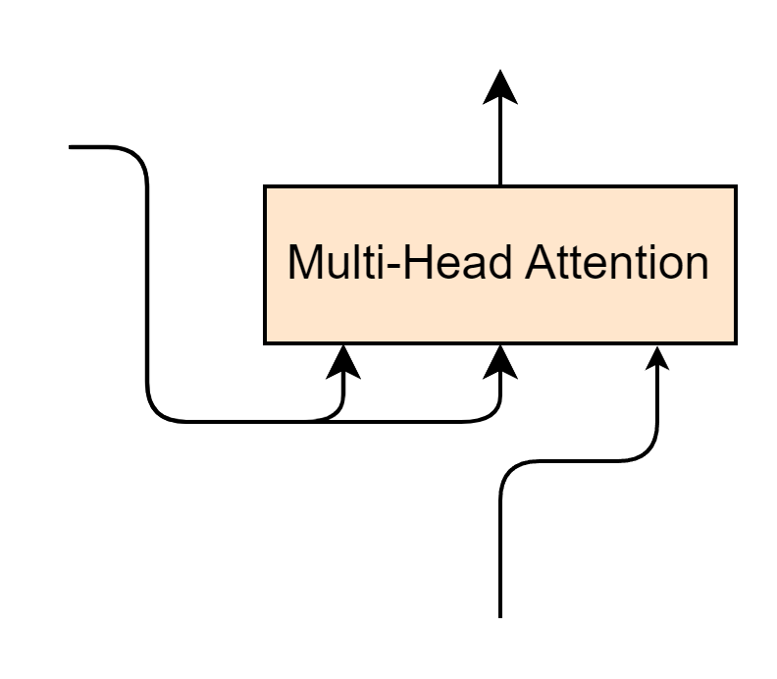




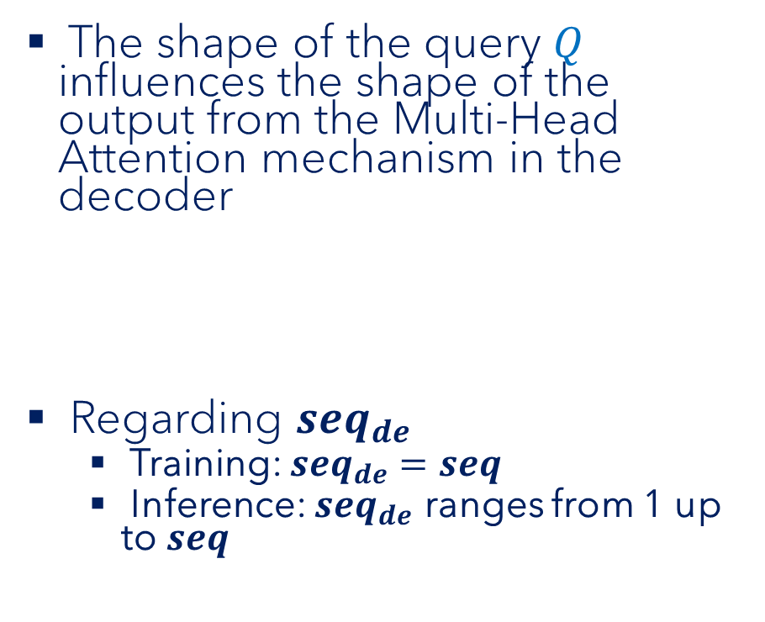



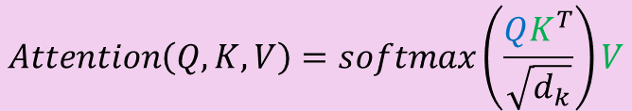



Multi-Head Attention for Decoder
The shape of the query $Q$ influences the shape of the output from the Multi-Head Attention mechanism in the decoder
Regarding $seq_{de}$
Training: $seq_{de}=seq$
Inference: $seq_{de}$ ranges from 1 up to $seq$
$$\left(batch, seq_{de}, d_{model}\right)$$
Encoder Output
$$\left(batch, seq, d_{model}\right)$$
$$K$$
$$V$$
$$Q$$
$$Q$$
$$K^{T}$$
$$V$$
$$\left(\left(seq_{de}, d_{model}\right)×\left(d_{model},seq\right)\right)×(seq, d_{model})$$
$$\left(seq_{de}, d_{model}\right)$$
$$\left(batch, seq_{de}, d_{model}\right)$$
$$Attention\left(Q, K, V\right)=softmax\left(\frac{QK^{T}}{\sqrt{d_{k}}}\right)V$$

Slide 82
Decoder | Put it all together

Slide 83







Decoder | Put it all together
Decoder Output
$$\left(batch, seq, d_{model}\right)$$
Multi-Head Attention
Masked Multi-Head Attention
Encoder Output
$$\left(batch, seq, d_{model}\right)$$
$$K$$
$$V$$
$$Q$$
$N_{x}$=6
Decoder Input
$$\left(batch, seq_{decoder}, d_{model}\right)$$

Slide 84
Output Generation

Slide 85
Output Generation
Projection layer
Linear layer
Softmax
Projection
Decoder
Encoder
Encoder Input
Decoder Input

Slide 86
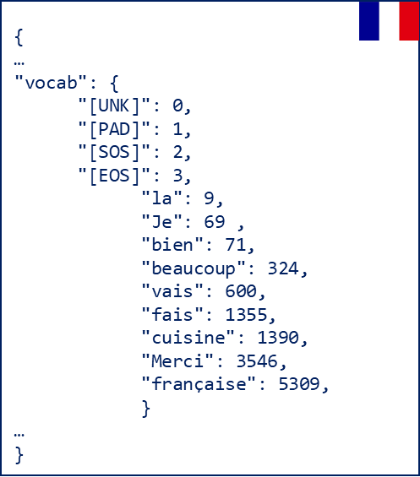



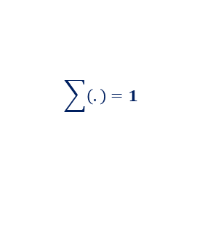







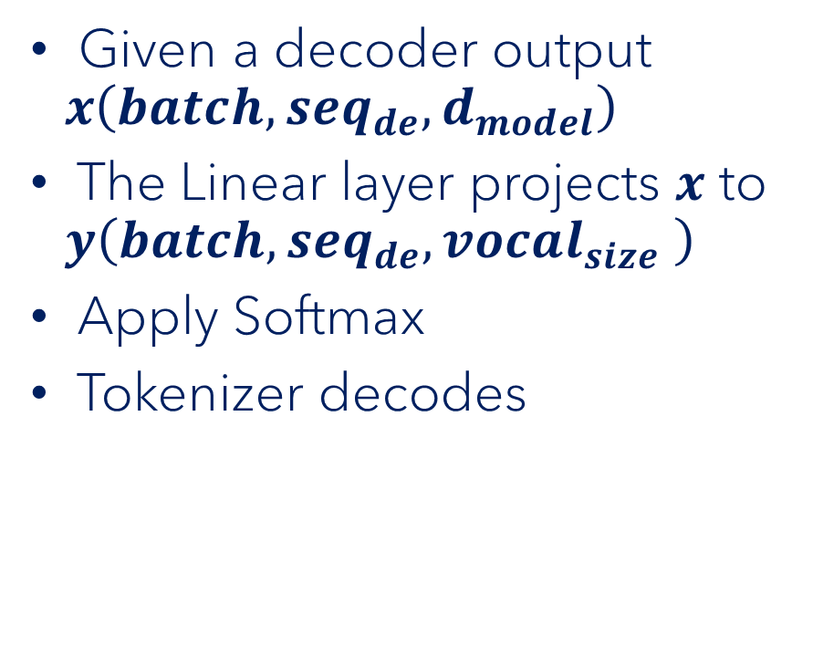



Output Generation
Target Tokenizer
"Je"
Given a decoder output $x\left(batch, seq_{de},d_{model}\right)$
The Linear layer projects $x$ to $y\left(batch, seq_{de},vocal_{size} \right)$
Apply Softmax
Tokenizer decodes
decode
$$vocal_size=10000$$
$$idx=69$$
0.03 | 0.04 | … | … | 0.86 | ... | … | … | … | 0.04
$$\sum{\left(.\right)}=1$$
$$softmax$$
3.42 | 4.65 | … | … | 86.45 | ... | … | … | … | 4.15
$$W$$
$$vocal_size=10000$$
$$Linear\left(x\right)=$$
$$x$$
$$×$$
$$+$$
$$b$$
Linear
$$\left(d_{model},vocal_size\right)$$
214.241 | 421.145 | … | 102.541 | 312.264
$$\left(seq_{de},d_{model}\right)$$
$$d_{model}=512$$

Slide 87
Congratulations
Projection
Decoder
Encoder
Encoder Input
Decoder Input

Slide 88
Transformer's Training Process

Slide 89
Training Process
Source language
Training
Transformer model
Target language
For Machine Translation task

Slide 90
Training Process
Target
"Il court vite"
t1
Il court vite<EOS>
Cross Entropy Loss
X Y Z
Decoder
Encoder
Update model parameters
<SOS> He runs fast <EOS>
<SOS> Il court vite
Source
Target
"He runs fast"
"Il court vite"

Slide 91
Training Process
Target
"Je t'aime"
t2
Je t'aime<EOS>
Cross Entropy Loss
I J K
Decoder
Encoder
Update model parameters
<SOS> I love <EOS>
<SOS> Je t'aime
Source
Target
"I love you"
"Je t'aime"

Slide 92
Transformer's Inference Process

Slide 93
Inference Process
Source
Target
"I am fine"
?

Slide 94
Inference Process
t1
Je
Decoder
Encoder
<SOS> I am fine <EOS>
<SOS>
Source
"I am fine"

Slide 95
Inference Process
t2
Je
Decoder
Encoder
<SOS> I am fine <EOS>
<SOS>
Source
"I am fine"

Slide 96
Inference Process
t2
vais
Decoder
Encoder
<SOS> I am fine <EOS>
<SOS> Je
Source
"I am fine"

Slide 97
Inference Process
t3
vais
Decoder
Encoder
<SOS> I am fine <EOS>
<SOS> Je
Source
"I am fine"

Slide 98
Inference Process
t3
bien
Decoder
Encoder
<SOS> I am fine <EOS>
<SOS> Je vais
Source
"I am fine"

Slide 99
Inference Process
t4
bien
Decoder
Encoder
<SOS> I am fine <EOS>
<SOS> Je vais
Source
"I am fine"

Slide 100
Inference Process
t4
Prediction:
"Je vais bien"
<EOS>
Decoder
Encoder
<SOS> I am fine <EOS>
<SOS> Je vais bien
Source
"I am fine"

Slide 101
What We Have Learned

Slide 102
What We Have Learned
NLP landscape before & after Transformer's arrival in 2017
Advantages & disadvantages of RNN
How Transformer has revolutionized AI & NLP since its arrival
Transformer's block-by-block
Training and inference processes in Transformer

